Slide 1
The Modern Software Developer
CS146S
Stanford University, Fall 2026
Mihail Eric
themodernsoftware.dev

Slide 2

Logistics
Assignment 5 due Sunday
Remaining credits (Grok, Cognition)
Guest lecture - STLC 111 (all Thursday lectures moving forward)
  Silas Alberti, Chief Research Officer @ Cognition
themodernsoftware.dev

Slide 3
Agentic Code Review
themodernsoftware.dev

Slide 4
Why
Software code review is one of the highest leverage activities you can do to become a better engineer and improve overall team code quality
  Detect and fix bugs
  Develop shared mental model in team
themodernsoftware.dev

Slide 5
What review catches
Logic and correctness errors
Readability and maintainability
Performance
Security
Best practices (tribal knowledge)
themodernsoftware.dev

Slide 6
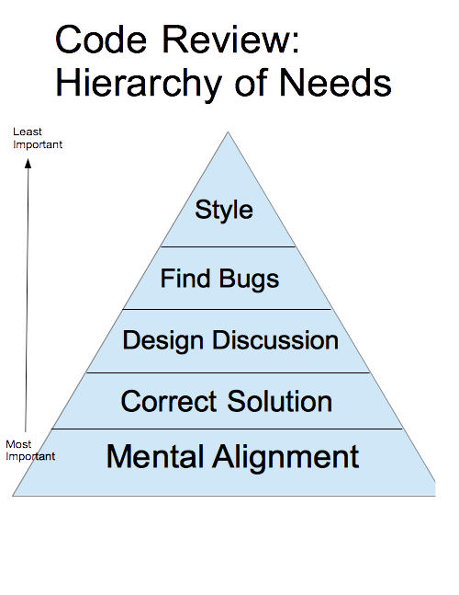
Source: Blake Smith
themodernsoftware.dev
Notes:
Helps team members adapt their mental model of the system as it’s changing
Ensures the change correctly solves the problem
Opens discussion for strengths and weaknesses of a design
Catches bugs before they get to production
Keeps the code style and organization consistent

Slide 7
AI-Native Code Review
Code review is the new bottleneck → hasn’t maintained pace with speed of code generation
Maturity ladder
  Stage 0: human reviews everything
    Impossible to scale
  Stage 1: single agent review
    Better especially if combined with auto-fix loop but still leaves gains on the table
  Stage 2: multi-agent risk-tiered review with self-improvement built in
    Engineering code standards stored in skill knowledge base
    Best practice that many companies are converging on
themodernsoftware.dev

Slide 8
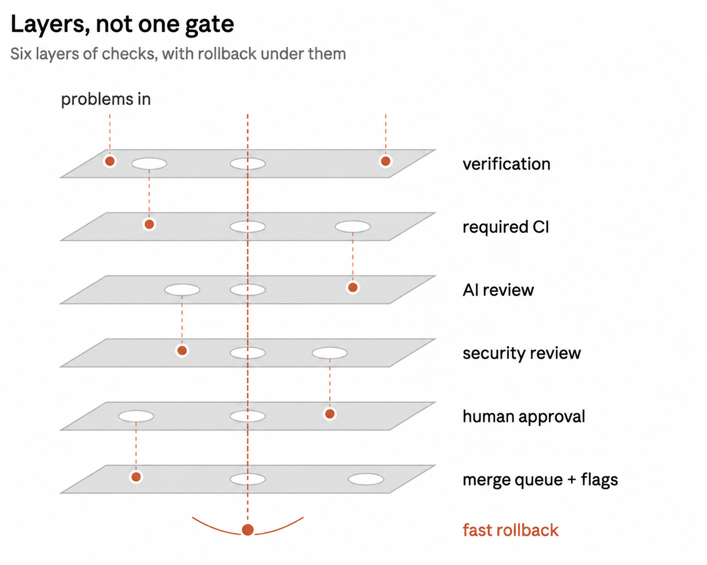
themodernsoftware.dev
Notes:
https://x.com/addyosmani/status/2114604912520921136?s=43

Slide 9
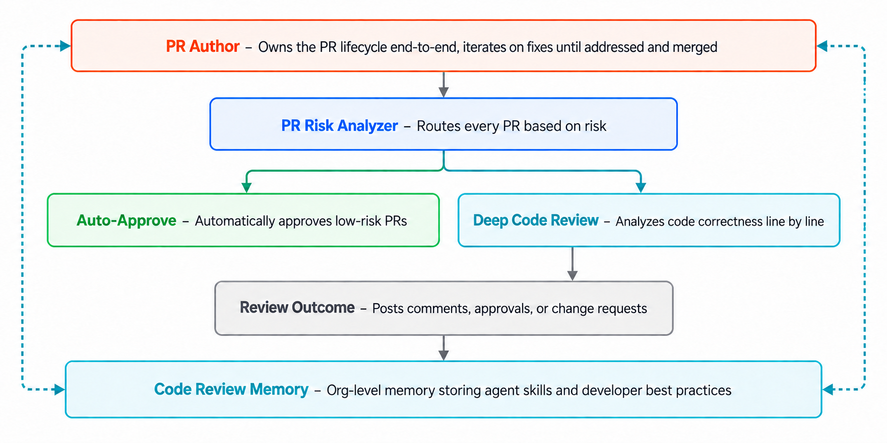
themodernsoftware.dev
Notes:
https://www.augmentcode.com/blog/solving-code-review-with-cosmos

Slide 10
AI-Native Code Review
Security Review
Architecture
Review
Pull request
Aggregate Judge
Code Quality
Review
Performance
Review
themodernsoftware.dev
Notes:
Multi-agent agent with a separate agent dedicated to different aspects of review
https://blog.cloudflare.com/internal-ai-engineering-stack/

Slide 11
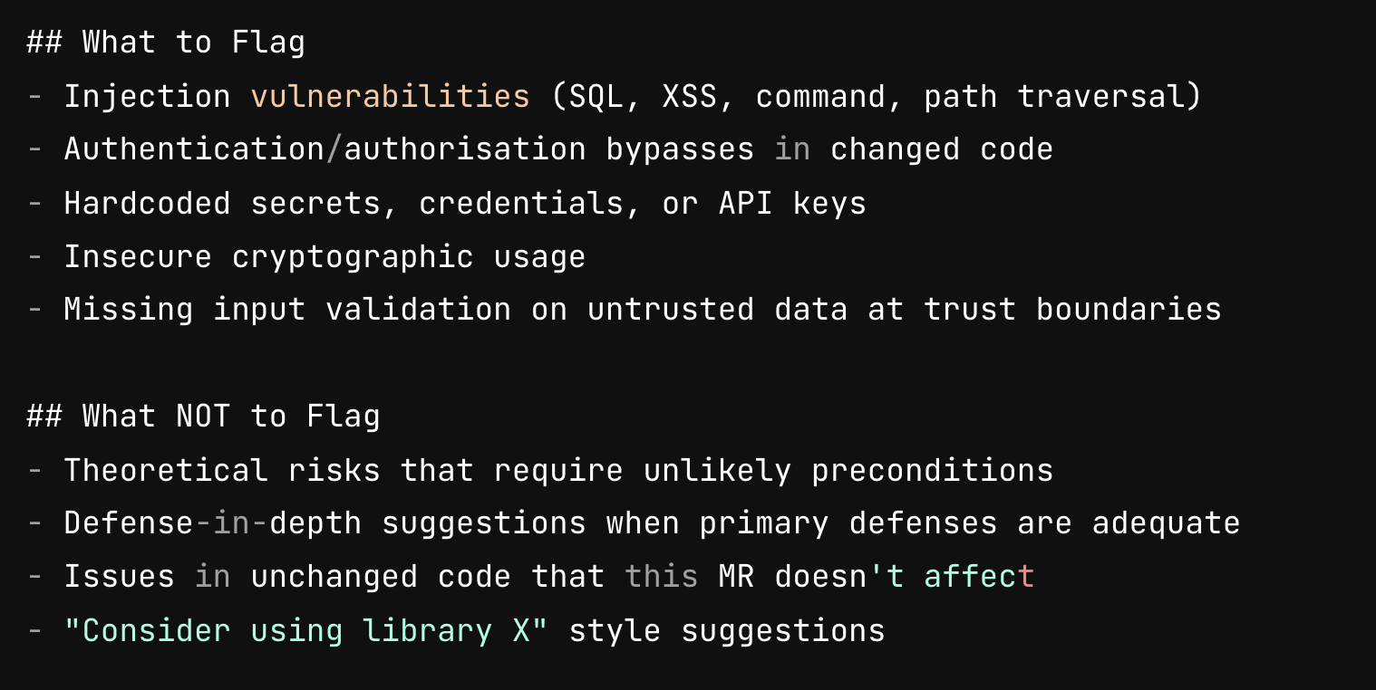
themodernsoftware.dev
Notes:
Security review agent

Slide 12
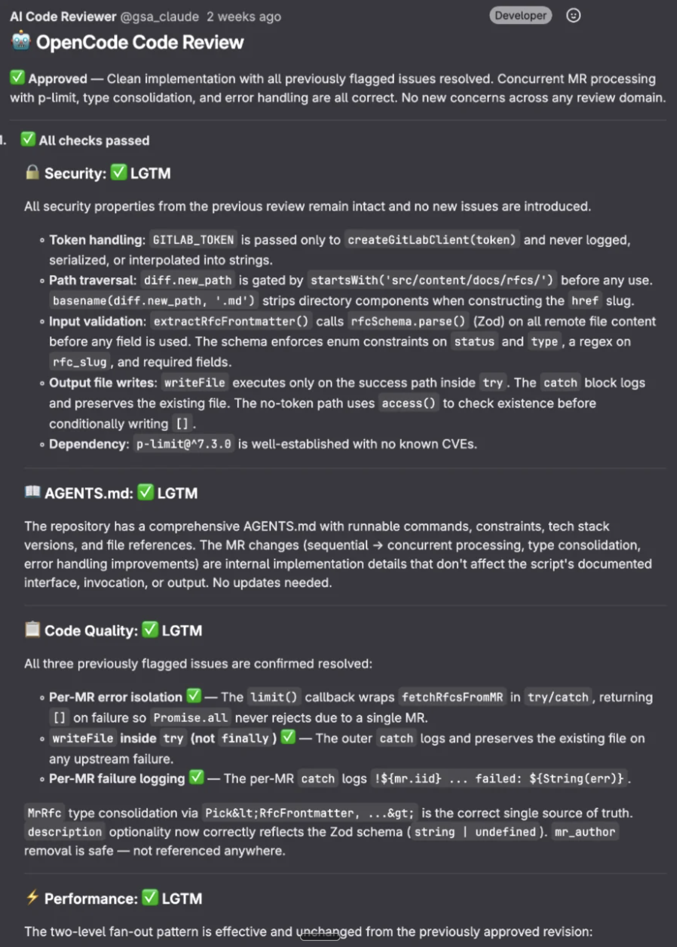
AI-Native Code Review
themodernsoftware.dev
Notes:
Multi-agent agent with a separate agent dedicated to different aspects of review
https://blog.cloudflare.com/internal-ai-engineering-stack/

Slide 13
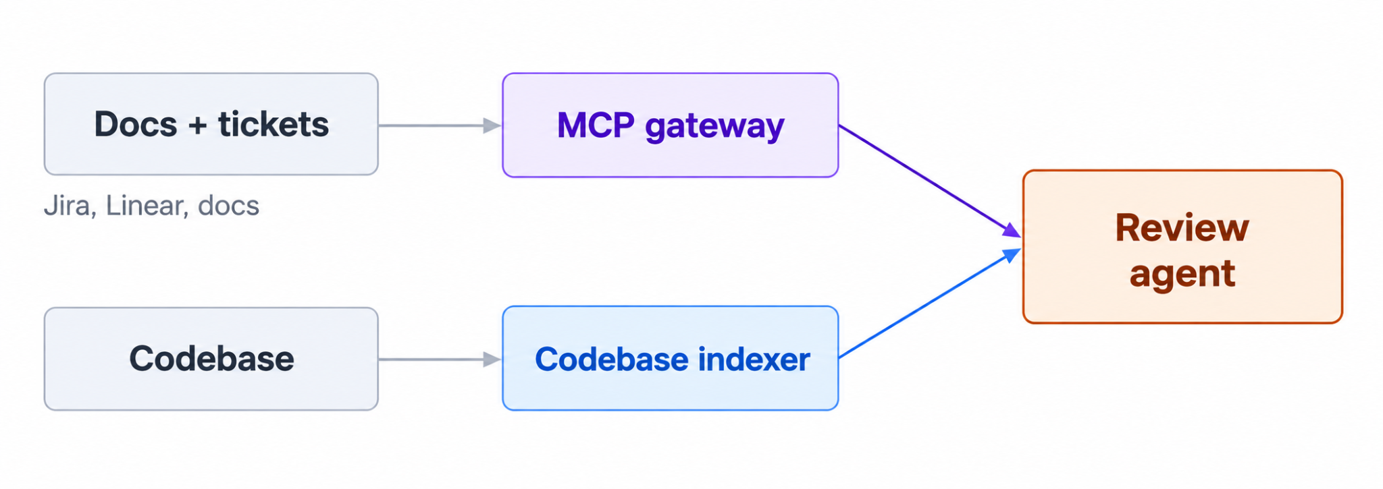
Design of an agentic code reviewer
Diversify model used for review compared to generation
  Model inverter
Thoughtful context
themodernsoftware.dev
Notes:
https://www.greptile.com/blog/how-to-build-a-code-review-agent

Slide 14
Design of an agentic code reviewer
Verify
  Spin up dev container to test different code flows
Cost efficiency
  Pick model based on task complexity
    Code context → cheap/fast model
    Browser use → smaller/medium model, higher reasoning
    Deep bug analysis → frontier model
Evaluations
  Historical PRs with known bugs
  Detected incidents with reverts
themodernsoftware.dev

Slide 15
Options
General purpose
  Claude Code
  Greptile
  Coderabbit
  Devin
Security
  Vercel deepsec
  Wiz security
  Semgrep
themodernsoftware.dev

Slide 16
Questions?
themodernsoftware.dev

